Slide 1

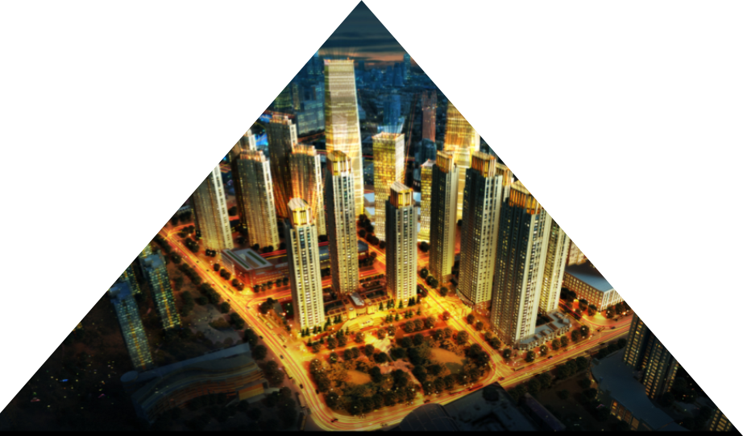
High Impact Skills Development Program
ROAD DETECTION USING
YOLO -5
Project Report
Submitted by :Ms Chand Safi

Slide 2


Overview of the Problem
Overview
A road detection and classification project using deep learning models to identify road types in challenging terrains.
Objective: To develop a model that can accurately classify various road types in real-time.

Slide 3
Sources
Sources: Road images from Gilgit-Baltistan region.
Method: Field photography and existing geographic datasets.
Dataset Size: 248 images across nine road types (e.g., Straight Road, Damaged Road, Turns).

Slide 4
Dataset Overview
Classes and Distribution:
Straight Road: 120 images
Damaged Road: 62 images
Right Turn: 27 images
Other Classes (show image counts briefly)
Splits: Training, Validation, and Test sets for each class.

Slide 5
Data Annotation
Tool Used: Roboflow
Annotation Process: Bounding boxes drawn around road features with specific tags.
Data Augmentation: Rotations, flipping, color adjustment, cropping.

Slide 6
Model Selection
YOLOv5 Chosen for real-time object detection and classification.
Why YOLO? High accuracy and efficiency suitable for real-time road monitoring.

Slide 7
Training Environment
Platform: Google Colab with GPU support.
Challenges: Frequent interruptions due to internet and power issues; resolved by using checkpoints.

Slide 8
Training Procedure
Configuration: Custom YAML file with classes and data splits.
Architecture: Customized backbone for small object detection.
Optimization: Early stopping and batch normalization to prevent overfitting.

Slide 9
Conclusion
Achievements: Developed a reliable model for road type detection.
Challenges Overcome: Connectivity and data limitations.
Future Steps: Dataset expansion, model fine-tuning, real-time deployment.

Slide 10




Challenges
04
03
02
01
Less Accuracy
ImBalance Dataset
Complex MODEL
• Internet Connectivity Challenges

Slide 11
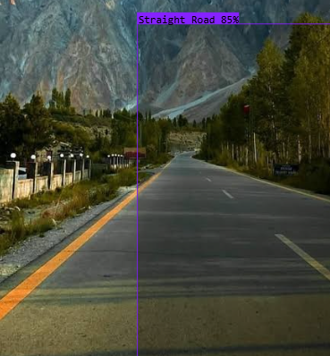
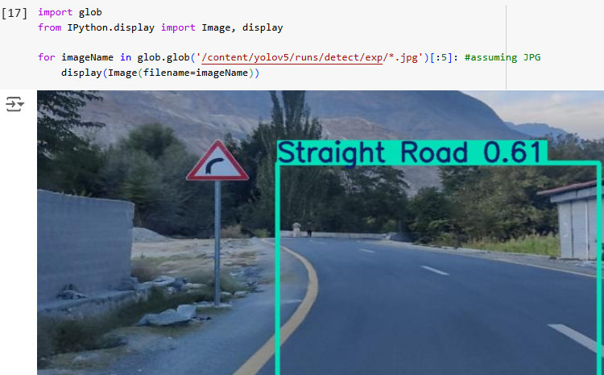
Results
•

Slide 12
Suggestions for Improvement
01
03
- Advanced data augmentation (random occlusions, brightness changes)
- Transfer learning with pre-trained models.
.
02
04
- Attention mechanisms for focusing on critical regions
.
- Ensemble learning to combine multiple architectures

Slide 13

Thank you

